Slide 1
Consistency and Replication

Slide 2
Why Replicate Data?
Enhance reliability.
Improve performance.
But: if there are many replicas of the same thing…
  How do we keep all of them up-to-date?
  How do we keep the replicas consistent?
Consistency can be achieved in a number of ways.
  We will study a number of consistency models as well as protocols for implementing the models.

Slide 3
More on Replication
Support DS goal of enhanced scalability:
  Replicas allow remote sites to continue working in the event of failures.
  Replicas Protect against data corruption.
  Replicas allow data to reside close to where it is used.
  Even a large number of replicated “local” systems can improve performance: think of clusters.
So, what’s the catch?
It is not easy to keep all those replicas consistent.

Slide 4
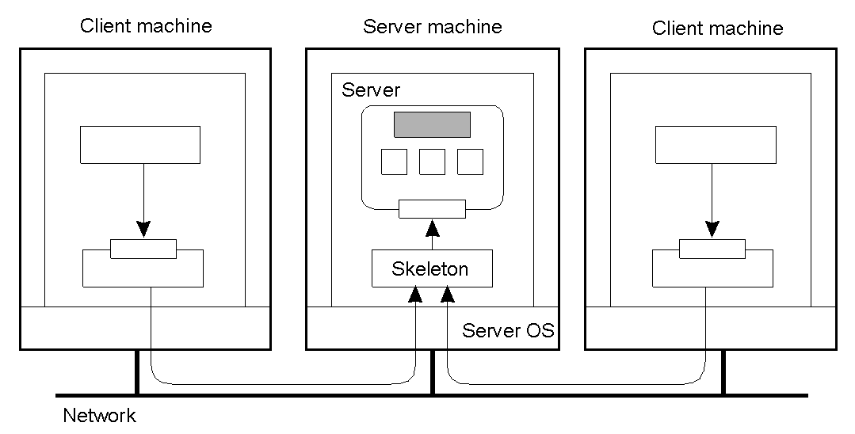
Concurrent Object Access: Problem
Organization of a distributed remote object shared by two different clients… but, how do we protect the object in the presence of multiple simultaneous access?

Slide 5
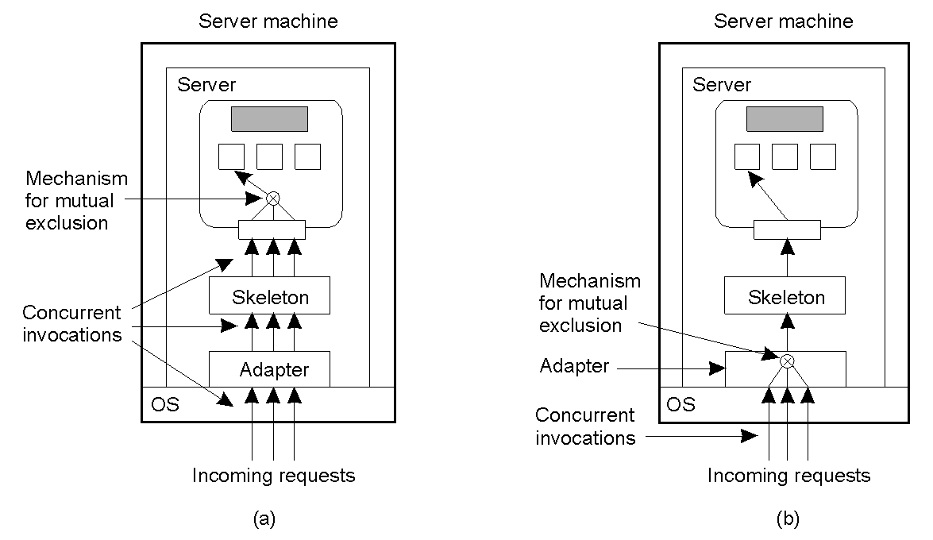
Concurrent Object Access: Solutions
(a) Remote object capable of handling concurrent invocations on its own (e.g. Java synchronization mechanisms).
(b) Remote object for which an adapter handles concurrent invocations (e.g. CORBA middleware adapters).

Slide 6
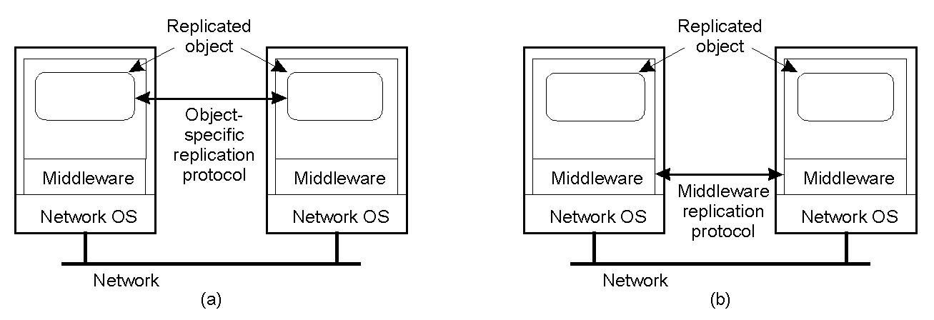
Object Replication: Solutions
(a) DS for replication-aware distributed objects – the object itself is “aware” that it is replicated (flexible set-up, but can be costly since DS developer has to deal with replication/consistency).
(b) DS responsible for replica management – less flexible, but removes the burden from the DS developer (most common approach).

Slide 7
Replication and Scalability
Replication is a widely-used scalability technique (e.g. web clients and web proxies).
  When systems scale, the first problems are associated with performance – as the systems get bigger (e.g., more users), they get often slower.
  Replicating the data and moving it closer to where it is needed helps to solve this scalability problem.
Problem remains: how to efficiently synchronize all of the replicas created to solve the scalability issue?
Dilemma: adding replicas improves scalability, but incurs (oftentimes) on overhead of keeping replicas up-to-date!!!
Solution often results in a relaxation of any consistency constraints.

Slide 8
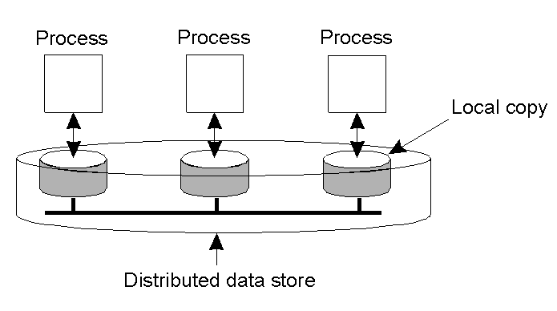
Data-Centric Consistency Models
Data-store can be read from or written to by any process in a DS.
Local copy of the data-store (replica) can support “faster reads”.
However, a write to a local replica needs to be propagated to all remote replicas.
Various consistency models help to understand the various mechanisms used to achieve and enable this.

Slide 9
What is a Consistency Model?
A “consistency model” is a CONTRACT between a DS data-store and its processes.
  If the processes agree to the rules, the data-store will perform properly as advertised.
We start with Strict Consistency, which is:
  Any read on a data item ‘x’ returns a value corresponding to the result of the most recent write on ‘x’ (regardless of where the write occurred).

Slide 10
Consistency Model Diagram Notation
W_{i}(x)a – a write by process ‘i’ to item ‘x’ with a value of ‘a’ (‘x’ is set to ‘a’).
  NB: The process is often shown as ‘P_{i}’.
R_{i}(x)b – a read by process ‘i’ from item ‘x’ producing the value ‘b’ (reading ‘x’ returns ‘b’).
  NB: Time moves from left to right in all diagrams.

Slide 11

Strict Consistency Diagrams
Behavior of two processes, operating on the same data item:
  A strictly consistent data-store.
  A data-store that is not strictly consistent.
With Strict Consistency, all writes are instantaneously visible to all processes and absolute global time order is maintained throughout DS.
  This is the “Holy Grail” consistency model – not at all easy in the real world, and all but impossible within a DS.
So, other less strict (“weaker”) models have been developed…

Slide 12
Sequential Consistency
Weaker consistency model with relaxation of rules
  It is also mutch easier (possible) to implement.
Definition of “Sequential Consistency”:
  The result of any execution is the same as if the (read and write) operations by all proceses on the data-store were executed in the same sequential order and the operations of each individual process appear in this sequence in the order specified by its program.

Slide 13

Sequential Consistency Diagrams
All processes see the same interleaving set of operations, regardless of what that interleaving is.
Data-store sequentially consistent – “first” write occurred after the “second” on all replicas.
Data-store not sequentially consistent – it appears the writes have occurred in a non-sequential order (NOT allowed).

Slide 14
Problem with Sequential Consistency
With this consistency model, adjusting the protocol to favour reads over writes (or vice-versa) can have a devastating impact on performance (refer to the textbook for the gory details).
For this reason, other weaker consistency models have been proposed and developed.
Again, a relaxation of rules allows for weaker models to make sense.

Slide 15
Causal Consistency
This model distinguishes between events that are “causally related” and those that are not.
  If event B is caused or influenced by an earlier event A, then causal consistency requires that every other process see event A and afterwards event B.
Operations that are not causally related are said to be concurrent.

Slide 16

More on Causal Consistency
A causally consistent data-store obeys this condition:
  Writes that are potentially causally related must be seen by all processes in the same order.
  Concurrent writes may be seen in a different order on different machines (i.e., by different processes).
This sequence is allowed with a causally-consistent store, but not with sequentially or strictly consistent store.
  NB: it is assumed that W₂(x)b and W₁(x)c are concurrent.

Slide 17
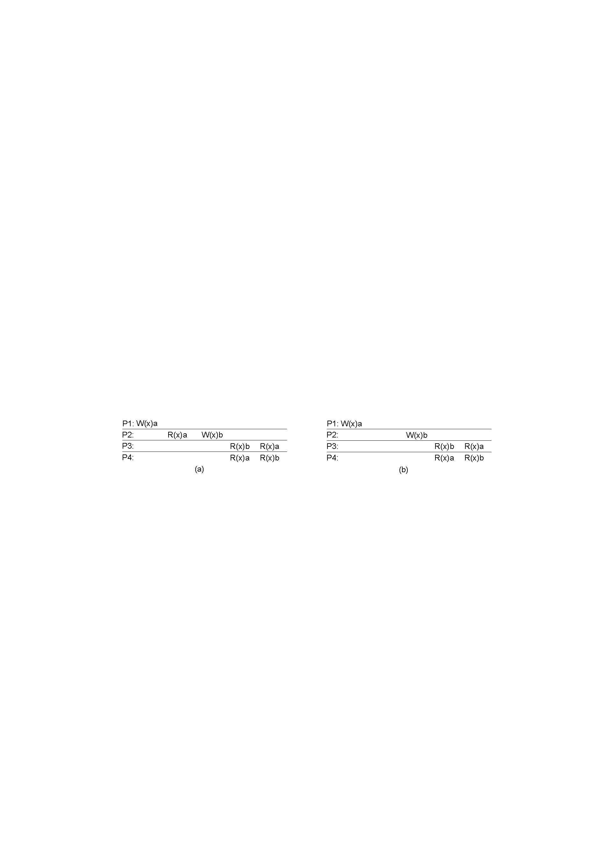
Another Causal Consistency Example
(a) Violation of causal-consistency: P2 write is related to P1 write due to read on ‘x’ giving ‘a’ (all processes must see them in same order).
(b) Causally-consistent data-store: the read has been removed, so the two writes are now concurrent (the reads by P3 and P4 are now OK).

Slide 18
FIFO Consistency
Defined as follows:
  Writes done by a single process are seen by all other processes in the order in which they were issued, but writes from different processes may be seen in different order by processes.
  This is also called “PRAM Consistency” (Pipelined RAM).
  Attractive characteristic of FIFO - easy to implement.
  There are no guarantees about the order in which different processes see writes – except that two or more writes from a single process must be seen in order.

Slide 19

FIFO Consistency Example
Valid sequence of FIFO consistency events.
  NB: none of the consistency models studied so far would allow this sequence of events.

Slide 20
Introducing Weak Consistency
Not all applications need to see all writes, let alone seeing them in the same order.
This leads to “Weak Consistency” (which is primarily designed to work with distributed critical regions).
This model introduces the notion of a “synchronization variable”, which is used to update all copies of the data-store.

Slide 21
Weak Consistency Properties
The 3 properties of Weak Consistency:
  Accesses to synchronization variables associated with a data-store are sequentially consistent.
  No operation on a synchronization variable is allowed to be performed until all previous writes have been completed everywhere.
  No read or write operation on data items are allowed to be performed until all previous operations to synchronization variables have been performed.

Slide 22
Weak Consistency: What It Means
So…
By doing a sync, a process can force the just written value out to all the other replicas.
Also, by doing a sync, a process can be sure it is getting the most recently written value before it reads.
In essence, the weak consistency models enforce consistency on a group of operations, as opposed to individual reads and writes (as with strict, sequential, causal and FIFO consistency).

Slide 23

Weak Consistency Examples
(a) Valid sequence of events for weak consistency (P2 and P3 have yet to synchronize, so there is no guarantees about value in ‘x’)
(b) Invalid sequence for weak consistency (P2 has synchronized, so it cannot read ‘a’ from ‘x’ – it should get ‘b’)

Slide 24
Introducing Release Consistency
Question:
  how does a weak consistent data-store knows that sync is the result of a read or a write?
  Answer: It doesn’t!
Possible to implement efficiencies if data-store is able to determine whether the sync is a read or write.
Two sync variables can be used:
  “acquire” and “release” - leads to “Release Consistency” model.

Slide 25
Release Consistency
Defined as follows:
  When a process does an “acquire”, the data-store will ensure that all the local copies of the protected data are brought up to date to be consistent with the remote ones if needs be.
  When a “release” is done, protected data that have been changed are propogated out to the local copies of the data-store.

Slide 26

Release Consistency Example
A valid event sequence for release consistency:
  Process P3 has not performed an acquire, so there are no guarantees that the read of ‘x’ is consistent (data-store is simply not obligated to provide the correct answer).
  P2 does perform an acquire, so its read of ‘x’ is consistent.

Slide 27
Release Consistency Rules
A distributed data-store is “Release Consistent” if it obeys the following rules:
  Before a read or write operation on shared data is performed, all previous acquires done by the process must have completed successfully.
  Before a release is allowed to be performed, all previous reads and writes by the process must have completed.
  Accesses to synchronization variables are FIFO consistent (sequential consistency not required).

Slide 28
Introducing Entry Consistency
A different twist is “Entry Consistency”: acquire and release are still used, and the data-store meets the following conditions:
  An acquire to synchronization variable is not allowed to perform with respect to a process until all updates to the guarded shared data have been performed with respect to that process.
  Before an exclusive mode access to a synchronization variable by a process is allowed to perform with respect to that process, no other process may hold the synchronization variable, not even in nonexclusive mode.
  After an exclusive mode access to a synchronization variable has been performed, any other process's next nonexclusive mode access to that synchronization variable may not be performed until it has performed with respect to that variable's owner.

Slide 29

Entry Consistency: What It Means
So, at an acquire, all remote changes to guarded data must be brought up to date.
  Before a write to a data item, a process must ensure that no other process is trying to write at the same time.
Locks associate with individual data items, as opposed to the entire data-store.
  NB: P2 read on ‘y’ returns NIL as no locks requested.

Slide 30
Summary of Consistency Models
Consistency | Description
Strict | Absolute time ordering of all shared accesses matters.
Linearizability | All processes must see all shared accesses in the same order. Accesses are furthermore ordered according to a (non-unique) global timestamp.
Sequential | All processes see all shared accesses in the same order. Accesses not ordered in time.
Causal | All processes see causally-related shared accesses in the same order.
FIFO | All processes see writes from each other in the order they were used. Writes from different processes may not always be seen in that order.
 | (a)
Consistency | Description
Weak | Shared data can be counted on to be consistent only after a synchronization is done.
Release | Shared data are made consistent when a critical region is exited.
Entry | Shared data are made consistent when a critical region is entered.
 | (b)
(a) Consistency models that do not use synchronization operations.
(b) Models that use synchronization operations: these require additional programming constructs, and allow programmers to treat the data-store as if it is sequentially consistent, when in fact it is not ( “should” also offer the best performance).

Slide 31
Client-Centric Consistency Models
The previously studied consistency models concern themselves with maintaining a consistent (globally accessible) data-store in the presence of concurrent read/write operations.
Another class of distributed datastores is characterized by the lack of simultaneous updates. Here, the emphasis is more on maintaining a consistent view of things for the individual client process that is currently operating on the data-store.

Slide 32
More Client-Centric Consistency
How fast should updates (writes) be made available to read-only processes?
  Think of most database systems: mainly read.
  Think of the DNS: write-write conflicts do no occur.
  Think of WWW: as with DNS, except that heavy use of client-side caching is present: even the return of stale pages is acceptable to most users.
These systems all exhibit a high degree of acceptable inconsistency… with the replicas gradually become consistent over time.

Slide 33
Toward Eventual Consistency
The only requirement is that all replicas will eventually be the same.
  All updates must be guaranteed to propogate to all replicas… eventually!
This works well if every client always updates the same replica.
Things are a little difficult if clients are mobile.

Slide 34
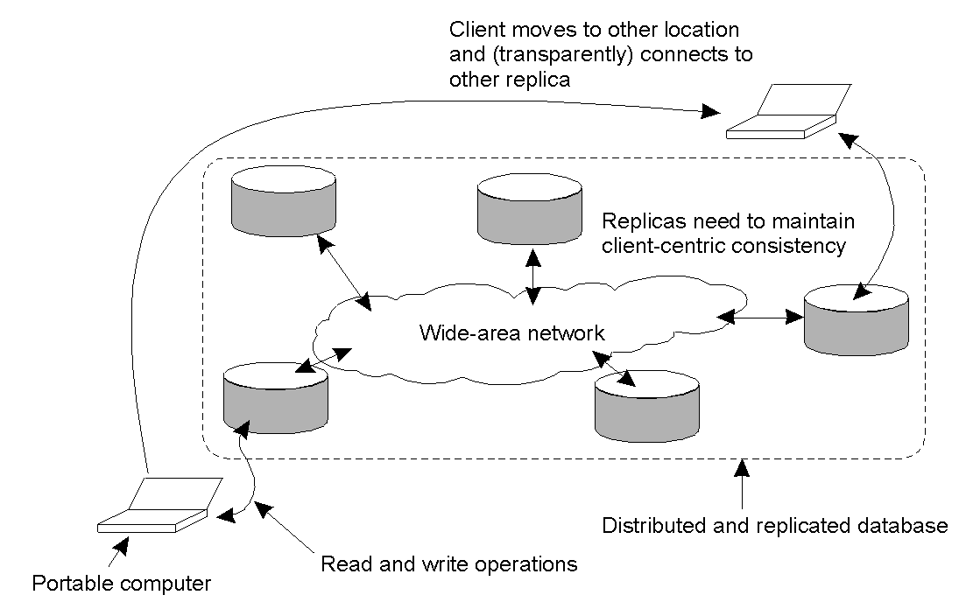
Eventual Consistency: Mobile Problems
A mobile user accessing different replicas of a distributed database.
When the system can guarantee that a single client sees accesses to the data-store in a consistent way, we then say that “client-centric consistency” holds.

Slide 35
An Example: The Bayou System
The Bayou System implements 4 models of Client-Centric Consistency:
  Monotonic-Read Consistency
  Monotonic-Write Consistency
  Read-Your-Writes Consistency
  Writes-Follow-Reads Consistency

Slide 36
More on Bayou, 1 of 2
Monotonic Reads: if a process reads the value of a data item ‘x’, any successive read operation on ‘x’ by that process will always return that same value or a more recent value.
Monotonic Writes: A write operation by a process on a data item ‘x’ is completed before any successive write operation on ‘x’ by the same process.

Slide 37
More on Bayou, 2 of 2
Read Your Writes: The effect of a write operation by a process on data item ‘x’ will always be seen by a successive read operation on ‘x’ by the same process.
Writes Follow Reads: A write operation by a process on a data item ‘x’ following a previous read operation on ‘x’ by the same process, is guaranteed to take place on the same or a more recent value of ‘x’ that was read.

Slide 38
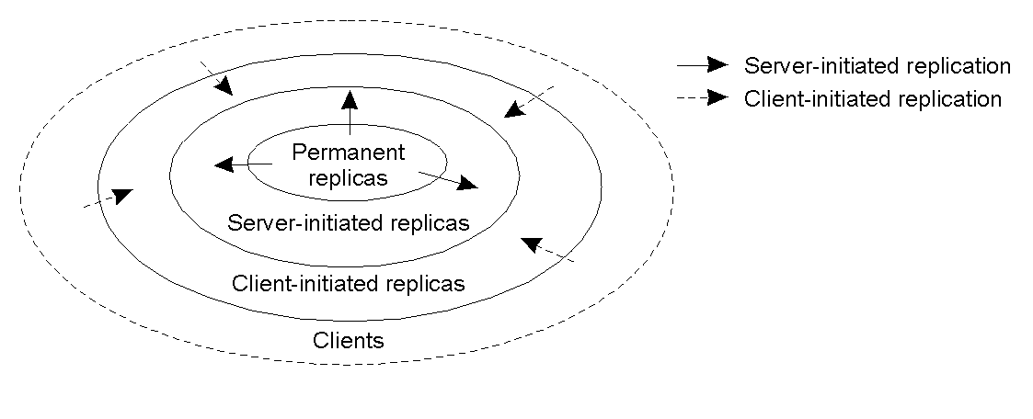
Distribution Protocols
Regardless of which consistency model is chosen, we need to decide where, when and by whom copies of the data-store are to be placed.

Slide 39
Replica Placement Types
There are 3 types of replica:
  Permanent replicas: tend to be small in number, organized as COWs (Clusters of Workstations) or mirrored systems.
  Server-initiated replicas: used to enhance performance at the initiation of the owner of data-store. Typically used by web hosting companies to geographically locate replicas close to where they are needed most (often referred as “push caches”).
  Client-initiated replicas: created as a result of client requests – think of browser caches. Works well, assuming of course, that the cached data does not go stale too soon.

Slide 40
Update Propagation
When a client initiates an update to a distributed data-store, what gets propagated?
  Propagate notification of the update to the other replicas – this is an “invalidation protocol” which indicates that the replica’s data is no longer up-to-date. Can work well when there’s many writes.
  Transfer the data from one replica to another – works well when there are many reads.
  Propagate the update to the other replicas – this is “active replication”, and shifts the workload to each of the replicas upon an “initial write”.

Slide 41
Push vs. Pull Protocols
Another design issue relates to whether or not the updates are pushed or pulled?
  Push-based/Server-based Approach: sent “automatically” by server, the client does not request the update.
    This approach is useful when a high degree of consistency is needed.
    Often used between permanent and server-initiated replicas.
  Pull-based/Client-based Approach: used by client caches (e.g., browsers), updates are requested by the client to the server.
    Hence, if no request, no update!

Slide 42
Push vs. Pull Protocols: Trade Offs
Issue | Push-based | Pull-based
State on server. | List of client replicas and caches. | None.
Messages sent. | Update (and possibly fetch update later). | Poll and update.
Response time at client. | Immediate (or fetch-update time). | Fetch-update time.
A comparison between push-based and pull-based protocols in the case of multiple client, single server systems.
Hybrid schemes are possible with e.g., “leases”:
  Promise from a server to push updates to a client for a period of time.
  Once lease expires, client reverts to pull-based (until another lease issued).

Slide 43
Epidemic Protocols
This is an interesting class of protocols that can be used to implement Eventual Consistency
  NB: these protocols are used in Bayou
The main concern is the propagation of updates to all the replicas in as few a number of messages as possible.
This “update propagation model”, intends to “infect” as many replicas as quickly as possible.
  Of course, we are spreading updates, not diseases!

Slide 44
Epidemic Protocols: Terminology
Infective replica: a server that holds an update that can be spread to other replicas.
Susceptible replica: a yet to be updated server.
Removed replica: an updated server that will not (or cannot) spread update to any other replicas.
The trick is to get all susceptible servers to either infective or removed states as quickly as possible without leaving any replicas out.

Slide 45
The Anti-Entropy Protocol
Entropy: “a measure of the degradation or disorganization of the universe”.
Server P picks Q at random and exchanges updates, using one of three approaches:
  P only pushes to Q.
  P only pulls from Q.
  P and Q push and pull from each other.
Sooner or later, all the servers in the system will be infected (updated) - Works well.

Slide 46
The Gossiping Protocol
This variant is referred to as “gossiping” or “rumour spreading”, as works as follows:
  P has just been updated for item ‘x’.
  It immediately pushes the update of ‘x’ to Q.
  If Q already knows about ‘x’, P becomes disinterested in spreading any more updates (rumours) and is removed.
  Otherwise P gossips to another server, as does Q.
This approach is good, but can be shown not to guarantee the propagation of all updates to all servers… Oh dear.

Slide 47
The Best of Both Worlds
A mix of anti-entropy and gossiping is regarded as the best approach to rapidly infecting systems with updates.
  However, what about removing data?
Updates are easy, deletion is much, much harder!
Under certain circumstances, after a deletion, an “old” reference to the deleted item may appear at some replica and cause the deleted item to be reactivated!
One solution is to issue “Death Certificates” for data items – these are a special type of update.
Only problem remaining is the eventual removal of “old” death certificates (with which timeouts can help).

Slide 48
Consistency Protocols
Specific implementation of a consistency model.
The most widely implemented models are:
  Sequential Consistency.
  Weak Consistency (with sync vars).
  Atomic Transactions (to be studied soon).

Slide 49
Primary-Based Protocols
Each data item is associated with a “primary” replica.
The primary is responsible for coordinating writes to the data item.
There are two types of Primary-Based Protocol:
  Remote-Write.
  Local-Write.

Slide 50
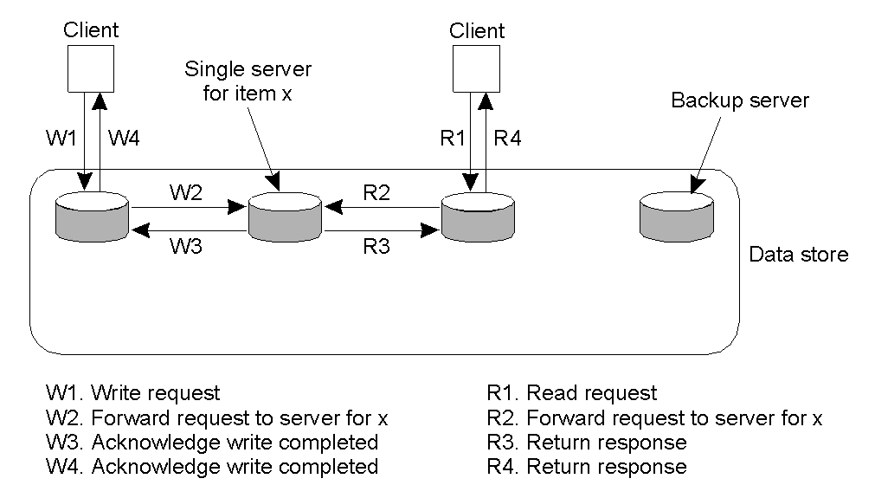
Remote-Write Protocols
With this protocol, all writes are performed at a single (remote) server.
This model is typically associated with traditional client/server systems.

Slide 51
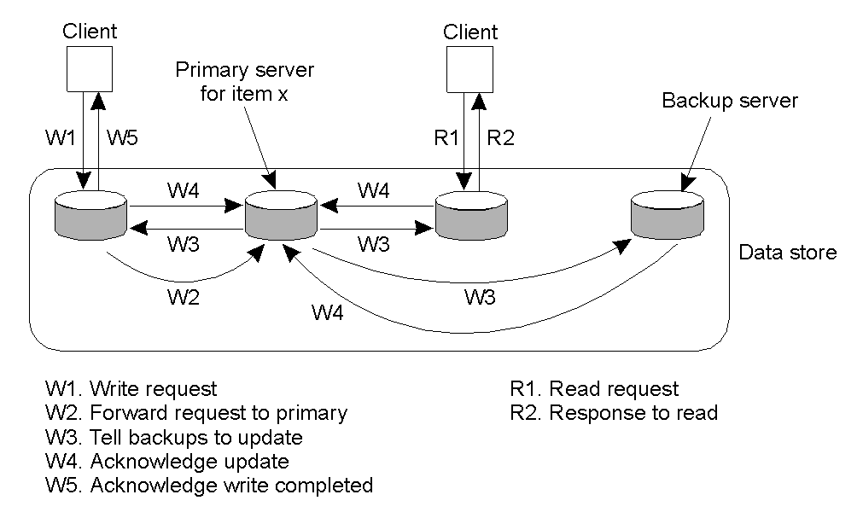
Primary-Backup Protocol: A Variation
Writes are still centralised, but reads are now distributed.
The primary coordinates writes to each of the backups.

Slide 52
The Bad and Good of Primary-Backup
Bad: performance
  All of those writes can take a long time (especially when a “blocking write protocol” is used)
  Using a non-blocking write protocol to handle the updates can lead to fault tolerant problems (which is our next topic).
Good: easy implementation
  The primary is in control, all writes can be sent to each backup replica IN THE SAME ORDER, making it easy to implement sequential consistency.

Slide 53
Local-Write Protocols
In this protocol, a single copy of the data item is still maintained.
Upon a write, the data item gets transferred to the replica that is writing.
  That is, the status of primary for a data item is transferrable.
This is also called a “fully migrating approach”.

Slide 54
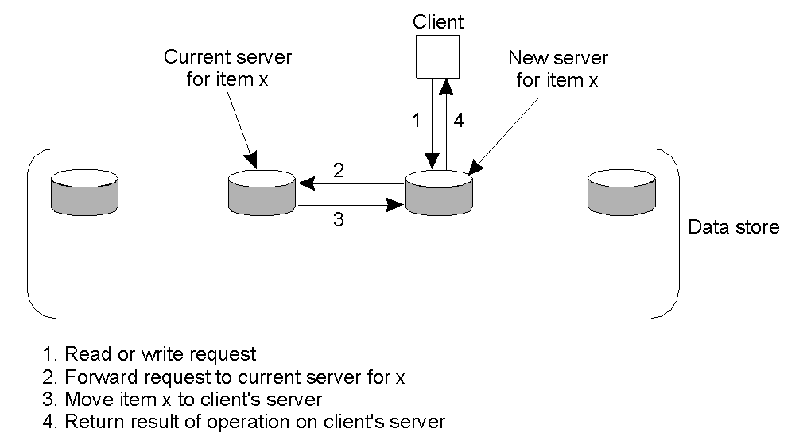
Local-Write Protocols Example
Primary-based local-write protocol in which a single copy is migrated between processes (prior to the read/write).

Slide 55
Local-Write Issues
The big question to be answered by any process about to read from or write to the data item is:
  “Where is the data item right now?”
It is possible to use some of the dymanic naming technologies studied earlier in this course, but scaling quickly becomes an issue.
Processes can spend more time actually locating a data item than using it!

Slide 56
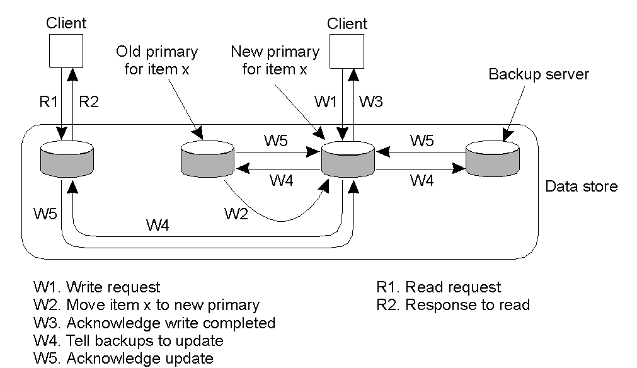
Local-Write Protocols: A Variation
Primary-backup protocol in which the primary migrates to the process wanting to perform an update, then updates the backups. Consequently, reads are much more efficient.

Slide 57
Replicated-Write Protocols
Writes can be carried out at any replica.
  AKA: “Distributed-Write Protocols”
There are 2 types:
  Active Replication.
  Majority Voting (Quorums).

Slide 58
Active Replication
A special process carries out the update operations at each replica.
  Lamport’s timsestamps can be used to achieve total ordering, but this does not scale well within DS.
An alternative/variation is to use a sequencer, which is a process that assigns a unique ID# to each update, which is then propogated to all replicas.
  Can lead to another problem: replicated invocations.

Slide 59
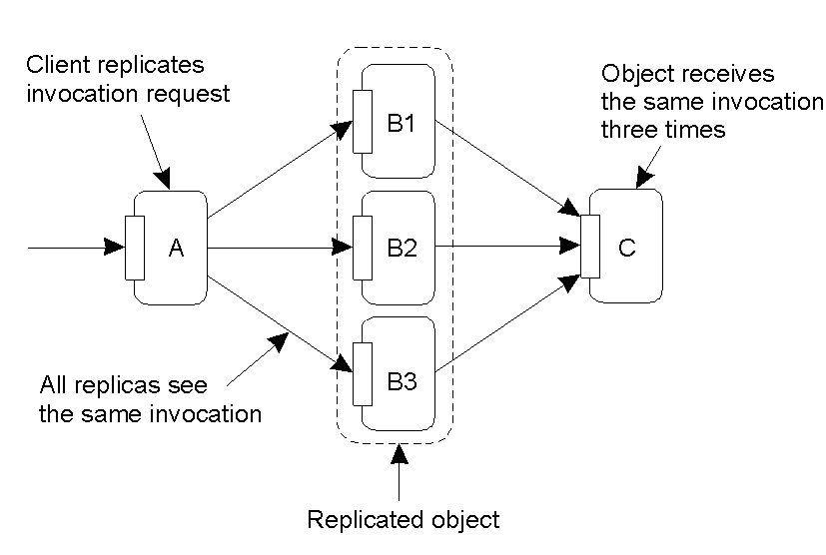
Active Replication: The Problem
The problem of replicated invocations – ‘B’ is a replicated object (which itself calls ‘C’). When ‘A’ calls ‘B’, how do we ensure ‘C’ is not invoked three times?

Slide 60
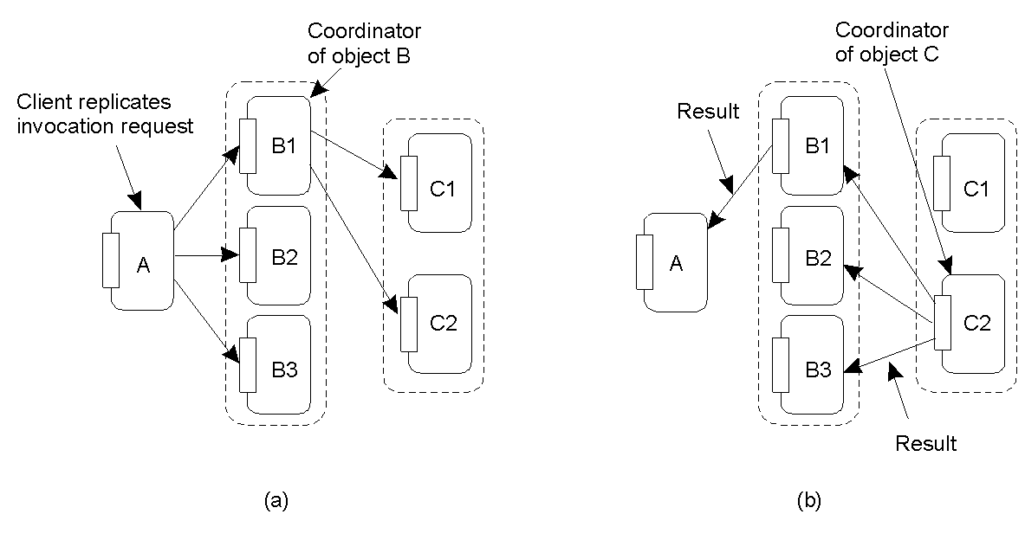
Active Replication: Solutions
(a) Using a coordinator for ‘B’, which is responsible for forwarding an invocation request from the replicated object to ‘C’.
(b) Returning results from ‘C’ using the same idea: a coordinator is responsible for returning the result to all ‘B’s. Note the single result returned to ‘A’.

Slide 61
Quorum-Based Protocols
Clients must request and acquire permissions from multiple replicas before either reading/writing a replicated data item.
Consider this example:
  A file is replicated within a distributed file system.
  To update a file, a process must get approval from a majority of the replicas to perform a write. The replicas need to agree to also perform the write.
  After the update, the file has a new version # associated with it (and it is set at all the updated replicas).
  To read, a process contacts a majority of the replicas and asks for the version # of the files. If the version # is the same, then the file must be the most recent version, and the read can proceed.

Slide 62
Quorum Protocols: Generalisation
N_{R} + N_{W} > N
N_{W} > N/2

Slide 63
Cache-Coherence Protocols
These are a special case, as the cache is typically controlled by the client, not the server.
Coherence Detection Strategy: when are inconsistencies detected?
  Statically at compile time: extra instructions inserted.
  Dynamically at runtime: code to check with the server.
Coherence Enforcement Strategy: how are caches kept consistent?
  Server Sent: invalidation messages.
  Update propagation techniques.
Combinations are possible.

Slide 64
What about Writes to the Cache?
Read-only Cache: updates are performed by the server (i.e., pushed) or by the client (i.e., pulled whenever the client notices that the cache is stale).
Write-Through Cache: the client modifies the cache, then sends the updates to the server.
Write-Back Cache: delay the propagation of updates, allowing multiple updates to be made locally, then sends the most recent to the server (this can have a dramatic positive impact on performance).

Slide 65
Consistency and Replication: Summary
Reasons for replication: improve…
  Performance
  Reliability
Replication can lead to inconsistencies…
How best can we propagate updates so that these inconsistencies are not noticed?
  With “best” meaning “without crippling performance”.
Proposed solutions focus on relaxation of existing consistency constraints.

Slide 66
Summary, continued
Various consistency models have been proposed:
  Strict, Sequential, Causal and FIFO concern themselves with individual reads/writes to data items.
  Weaker models introduce the notion of sync variables:
    Release & Entry concerned with groups reads/writes.
  These models are known as “Data-Centric”.
“Client Centric” models also exist:
  Concerned with maintaining consistency for a single clients’ access to the distributed data-store.
  The Eventual Consistency model is an example.

Slide 67
End of Summary
Distribute (“propagate”) updates:
  WHAT is propagated,
  WHERE it is propagated
  WHOM is propagated
Distribution Protocols and Consistency Protocols designed to facilitate propagation of updates.
Most widely implemented schemes are those that support Sequential Consistency or Weak Consistency with Sync Variables.

